Slide 1
Seismic to Well Ties
Objectives of the seismic - well tie
What is a good well-seismic tie?
Comparing well with seismic data
Preparing well data
Preparing seismic data
How to tie synthetics to seismic data.
Pitfalls
Schroeder (2006) Courtesy of ExxonMobil

Slide 2
Objectives of Well-Seismic Ties
Well-seismic ties allow well data, measured in units of depth, to be compared to seismic data, measured in units of time.
This allows us to relate horizon tops identified in a well with specific reflections on the seismic section.
A “synthetic” is a 1D, zero offset seismic model using sonic and density logs, a wavelet and a time to depth function.
The synthetic trace is compared to the real seismic data collected near the well location
Schroeder (2006) Courtesy of ExxonMobil

Slide 3
North Sea Rock Property Data

Slide 4
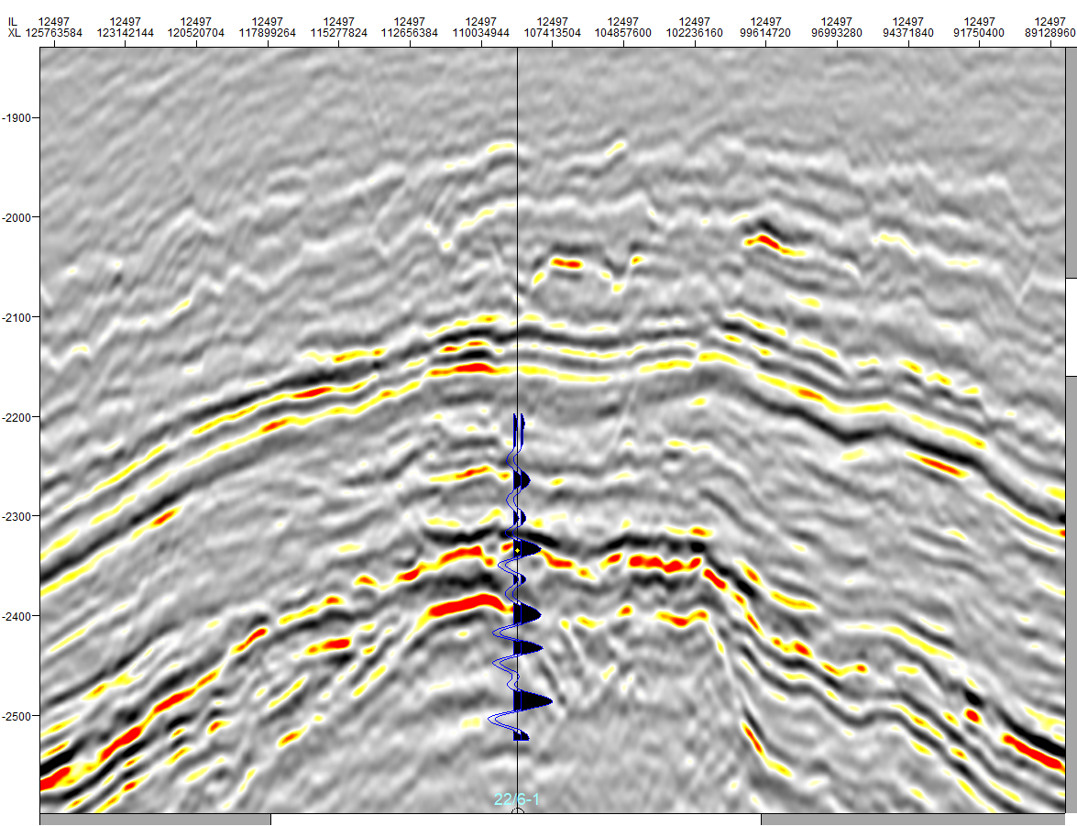
North Sea Well Tie
GR SW PHI VP RHOB P Imp Synth

Slide 5
Measurements In Time and In Depth
Seismic: Time Units
Log: Depth Units
SHOT
RECV
Kelly Bushing
Elevation (KB)
Surface Elevation
Base of Weathering
Sea Floor
Measured Depth (MD)
Measured Depth (MD)
Two-way time (TWT)
True Vertical depth (TVD)
Depth Below Mud Line
Schroeder (2006) Courtesy of ExxonMobil

Slide 6
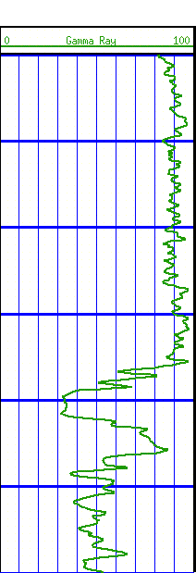
Comparison of Seismic and Well Data
Seismic Data
Samples area and volume
Low frequency 5 - 60 Hz
Vertical resolution 15 - 100 m
Horizontal resolution 150 - 1000 m
Measures seismic amplitude, phase, continuity, horizontal & vertical velocities
Time measurement
Well Data
Samples point along well bore
High frequency, 10,000 - 20,000 Hz
Vertical resolution 2 cm - 2 m
Horizontal resolution 0.5 cm - 6 m
Measures velocity, density, resistivity, radioactivity, SP, …
Depth measurement
100 m
100 m
Schroeder (2006) Courtesy of ExxonMobil

Slide 7
Seismic-Well Tie Flow-Chart
Seismic Data
Data Processing
Real Seismic Trace
Estimate
Wavelet
Well – Seismic Tie
Well -
Data Processing
Seismic Modeling
Synthetic Seismic Trace
Well Data
Check Shots/ Time Depth
Schroeder (2006) Courtesy of ExxonMobil

Slide 8
Check Shot/VSP Data
Check shots measure the vertical one-way time (OWT) from surface to various depths (geophone positions) within the well
Used to calibrate the relationship between well depths and times calculated from a sonic log
Seismic Shot
Depth
Time
Borehole Geophone
Schroeder (2006) Courtesy of ExxonMobil

Slide 9
Wavelets
Common Wavelet Shapes
Two options for defining a wavelet:
Use software that estimates the Wavelet based on a ‘window’ of the real seismic data at the well (recommended)
Statistical (seismic only) > Best initially
Deterministic (seismic & well) > Best after good initial well tie
Use a standard Wavelet shape specifying polarity, peak frequency, and phase:
Minimum phase
Zero phase
Quadrature
Minimum Phase
Zero Phase
Quadrature
Phase
Impedance
RC
Positive
Reflection
Coefficient
Schroeder (2006) Courtesy of ExxonMobil

Slide 10
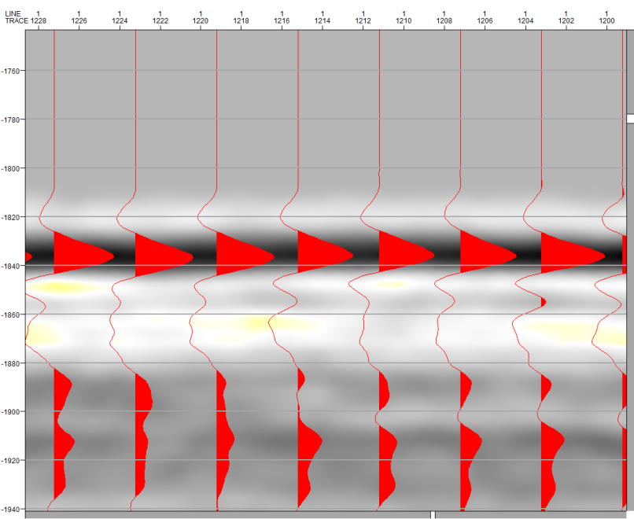
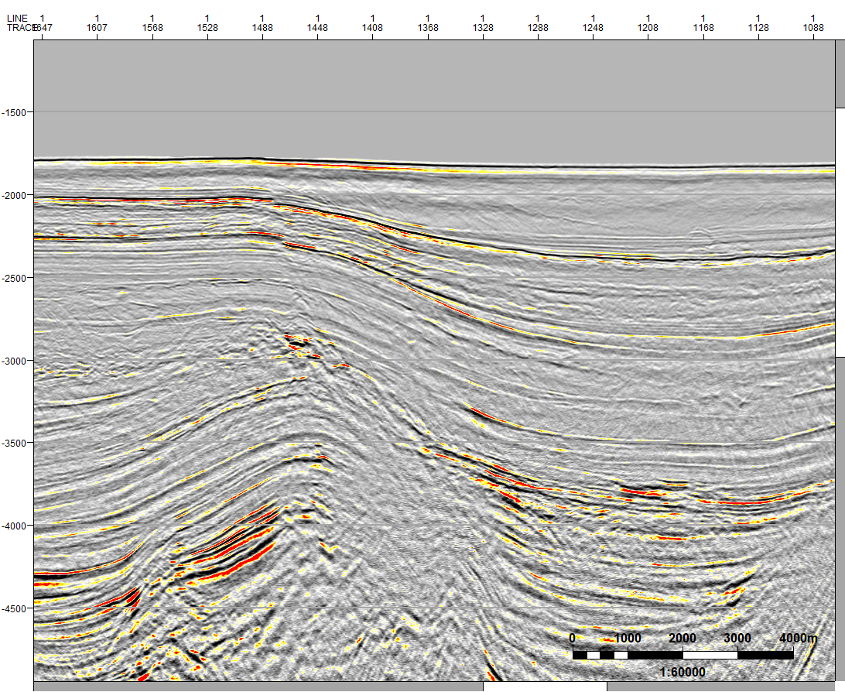
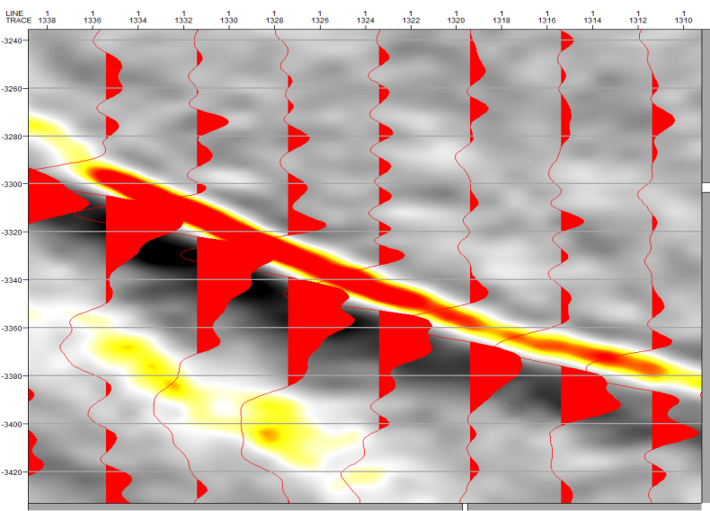
Using the Water Bottom

Slide 11


The Modeling Process
Reflection
Coefficients
Lithology
Velocity
Density
Impedance
Wavelet
Synthetic
Shale
Sand
x
=
⇒
⇒
⇒
*
Shale
Sand
Shale
We use the velocity (sonic) and density logs to compute an impedance log
We calculate the reflection coefficients from impedance: ΔI/(I₁+I₂)
We convolve the wavelet with the RC series to get individual wavelets
Each RC generates a wavelet whose amplitude is proportional to the RC
We sum the individual wavelets to get the synthetic seismic trace
Schroeder (2006) Courtesy of ExxonMobil

Slide 12
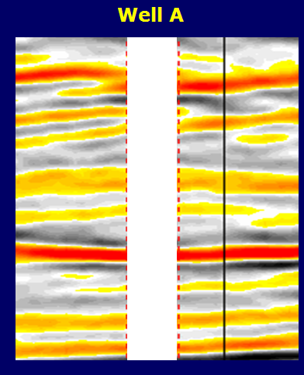
Tying Synthetic to Seismic Data
Position of
Synthetic Trace
Position synthetic trace on seismic line.
Project synthetic along structural or stratigraphic strike if well is off line (2D)
Time (ms)
Schroeder (2006) Courtesy of ExxonMobil

Slide 13
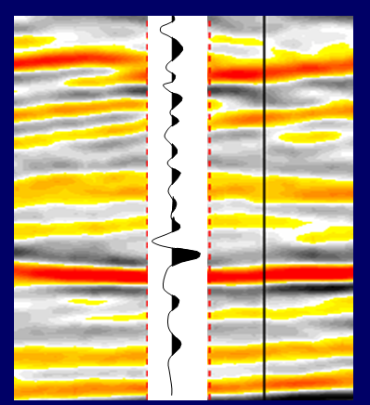
Tying Synthetic to Seismic Data
Synthetic Trace
Position synthetic trace on seismic line.
Project synthetic along structural or stratigraphic strike if well is off line (2D)
Reference datum of synthetic to seismic data (usually ground level, sea level or seismic datum)
Without check shots, estimate start time of first bed or tie to known horizon
Time (ms)
Schroeder (2006) Courtesy of ExxonMobil

Slide 14
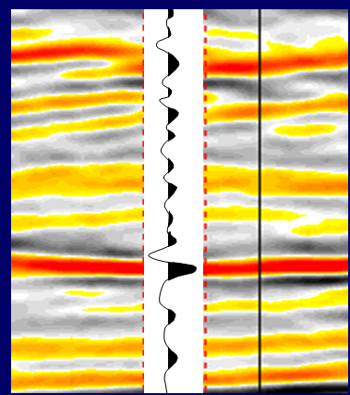
Tying Synthetic to Seismic Data
Synthetic Trace
Position synthetic trace on seismic line.
Project synthetic along structural or stratigraphic strike if well is off line (2D)
Reference datum of synthetic to seismic data (usually ground level, sea level or seismic datum)
Without check shots, estimate start time of first bed or tie to known horizon
Shift synthetic in time to get the best character tie (if needed)
Not unusual, but need to investigate why you need a shift
Time (ms)
Schroeder (2006) Courtesy of ExxonMobil

Slide 15
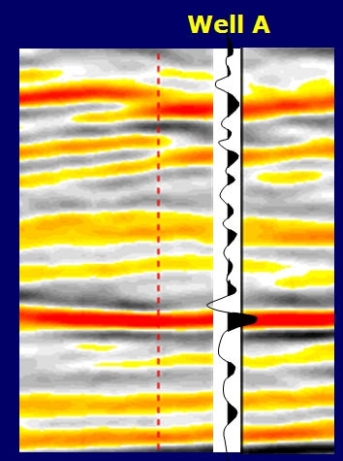
Tying Synthetic to Seismic Data
Accept the tie that yields best character tie with least time shift in the zone of interest (reservoir)
Seal
The top of the reservoir should be mapped on this peak (red)
Reservoir
Zone
Schroeder (2006) Courtesy of ExxonMobil

Slide 16
Assumptions for Synthetic Well Ties
Seismic Data
Noise free
No multiples
Relative amplitudes are preserved
Zero-offset section
Synthetic Seismograms
Logs representative of the earth sampled by the seismic data
Normal incidence reflection coefficients
Multiples ignored
No transmission losses or absorption
Isotropic medium (vertical and horizontal velocities are equal)
Schroeder (2006) Courtesy of ExxonMobil

Slide 17
Common Pitfalls
Error in well or seismic location
washout zones, drilling-fluid invasion effects
Log data quality
washout zones, drilling-fluid invasion effects
Seismic data quality
noise, multiples, amplitude gain, migration, etc
Incorrect wavelet
Polarity, frequency, and phase (Try a different wavelet; use extracted wavelet)
Incorrect 1-D model
Logs, check shots need further editing
Incorrect start time or improper datuming
Amplitude-Versus-Offset (AVO) effects
Bed tuning …
Schroeder (2006) Courtesy of ExxonMobil

Slide 18
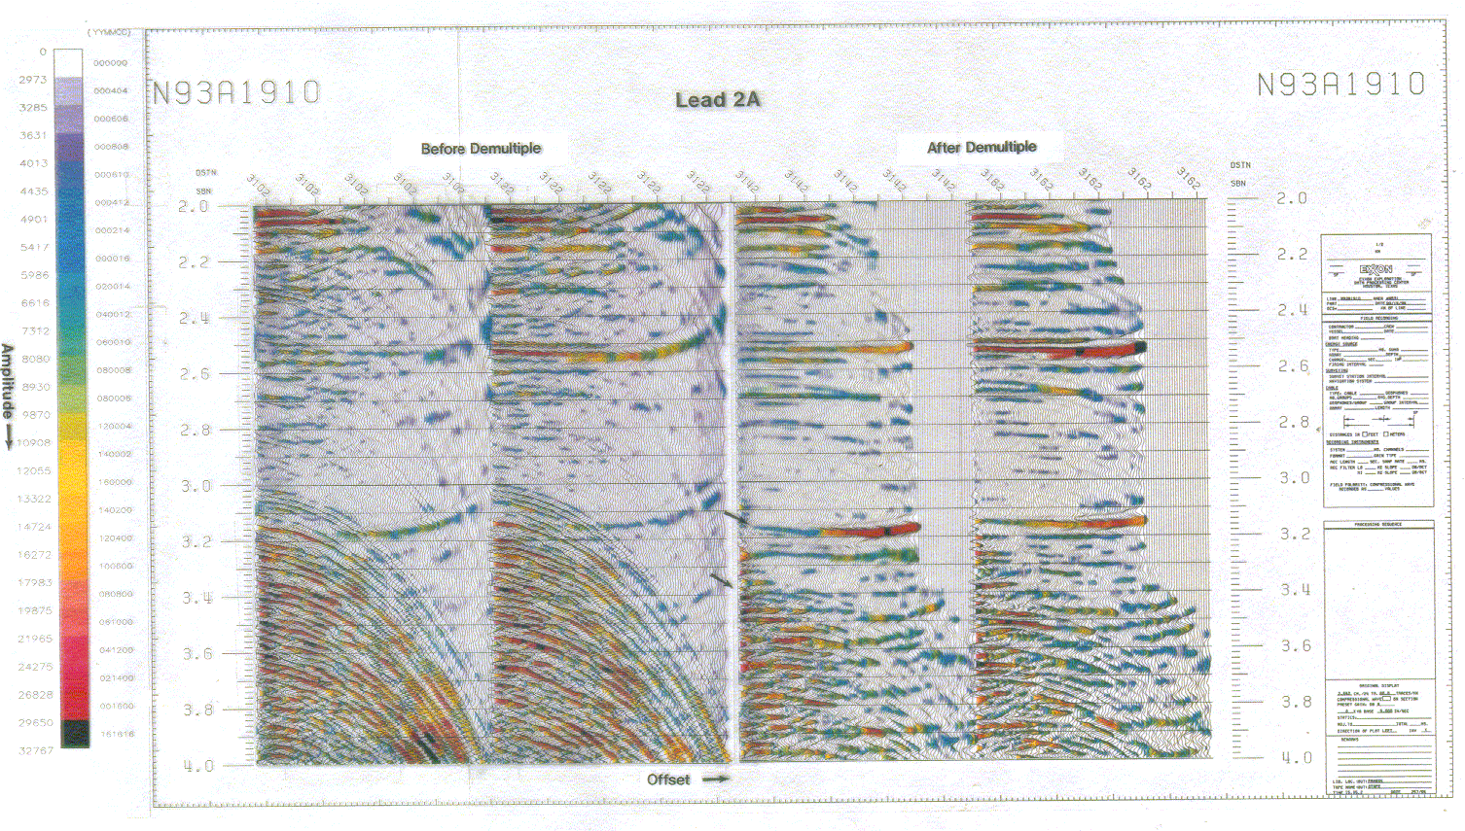
Pitfalls – AVO
R(θ) ~= R₀COS²θ + 2.25ΔσSIN²θ
Δσ=σ₂-σ_{1,} σ _{(Poisson's Ratio)}
θ = Angle of incidence
Offset
CDP Location
Sources
Offset
Receivers
θ
Time
Shallow Beds
Depth
Time
Multiples
Deep Beds
Notes:
On this slide I have an example of AVO information in a gather.
On the right is the CDP acquisition diagram. You can see that as the offsets vary, the angle that the energy reflects off the beds changes. As we saw in the last slide, this changes the contrbutions that Impedance and VP/Vs make to the reflection amplitude.Thus, at every different offset, the reflectivity will be different.
On the gather we can see some obvious example of this.
High amplitude on near - Class I. Increases with offset indicating that it’s a valid hydrocarbon anomaly.
Deeper reflection - moderate to low amplitude on near. Class II which might have been missed on stacked data. Here we can see that it has a dramatic increase in amplitude with offset - Hydrocarbons.
If you look more closely you canb see that eacj reflection has a unique change in amplitude with offset. Many that would be similar oin stacked data are very different in the gather.
Two shallower moderate amplitude reflection. On the stacked data they are brighter than the class 2 anomaly. However on the gather they decrease in amplitude with offset, indicating no hydrocarbons.

Slide 19
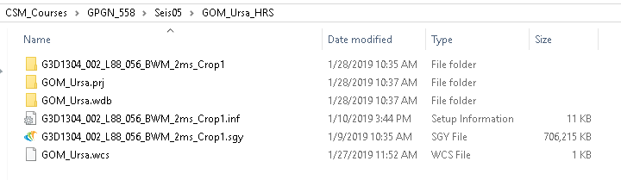
Hampson Russell Exercise

Slide 20
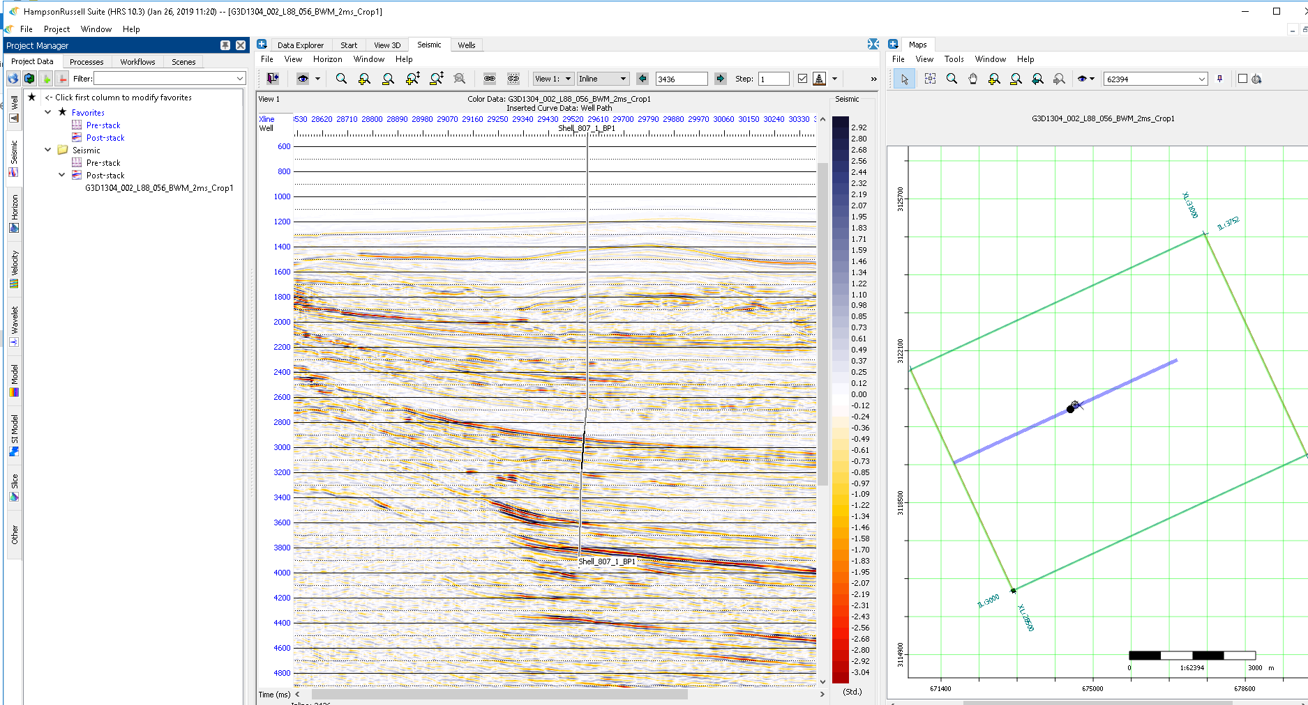
Hampson Russell Exercise

Slide 21
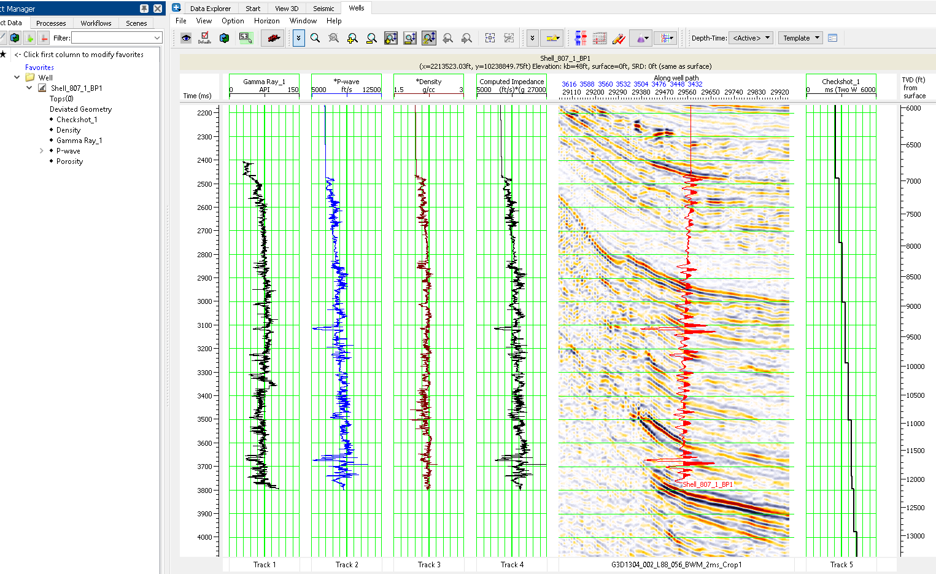
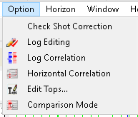
Hampson Russell Exercise – Check Shot Correction

Slide 22
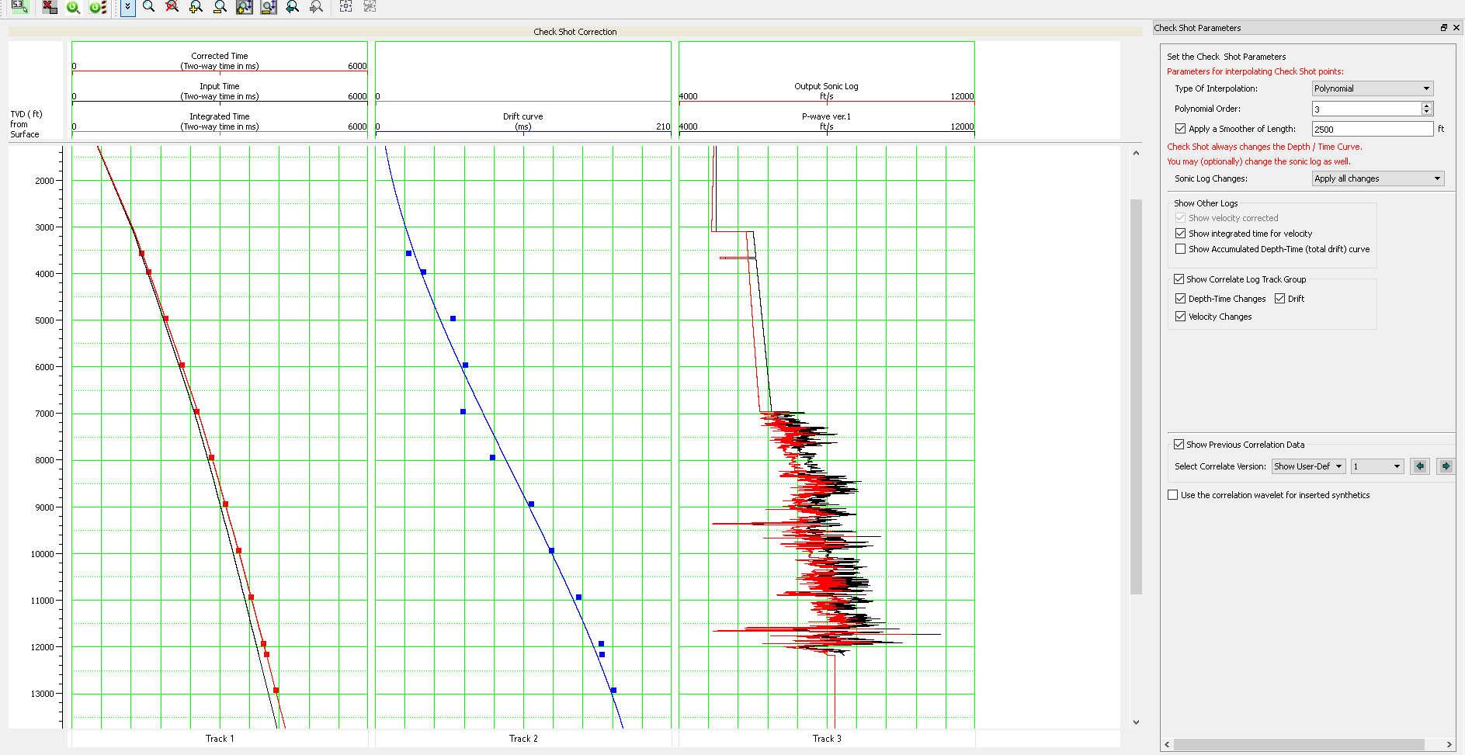
Hampson Russell Exercise – Check Shot Correction

Slide 23
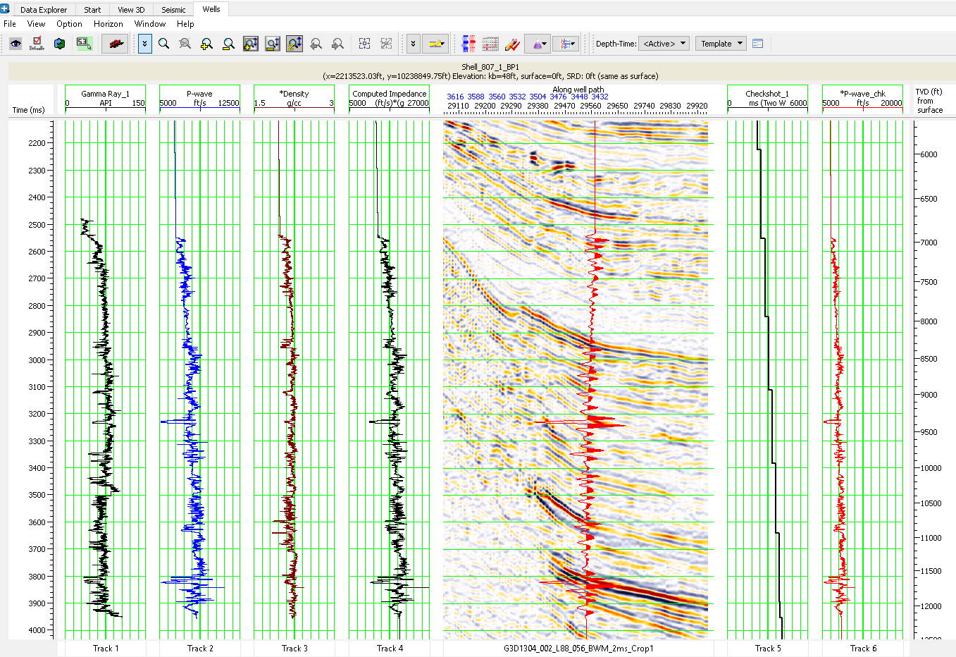
Hampson Russell Exercise – Check Shot Correction

Slide 24
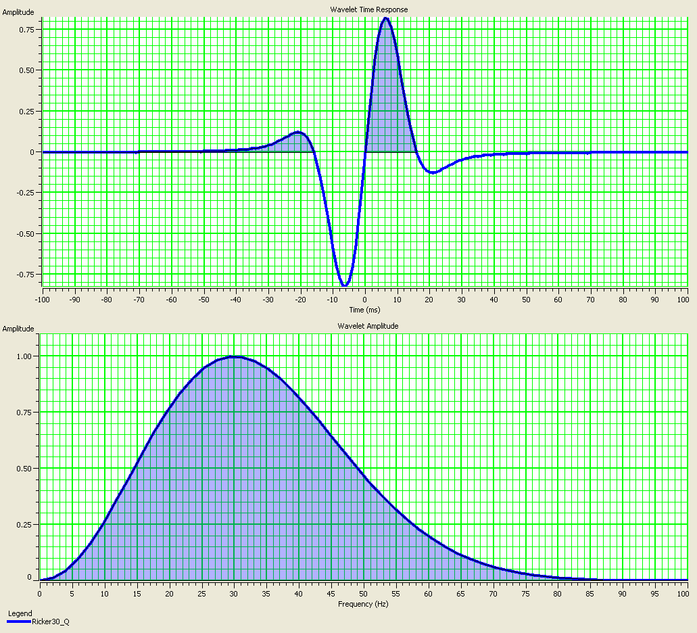
Hampson Russell Exercise – Ricker Wavelet
Wavelet – 30Hz Ricker Quad

Slide 25
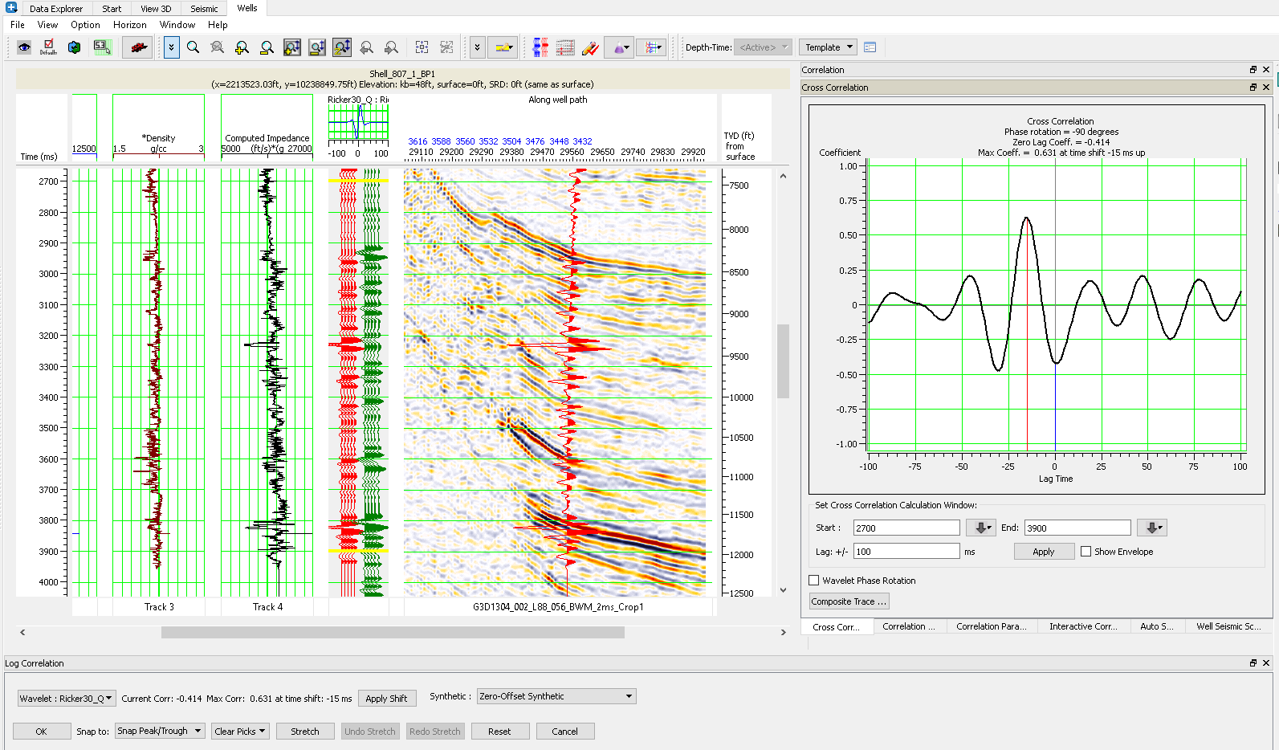
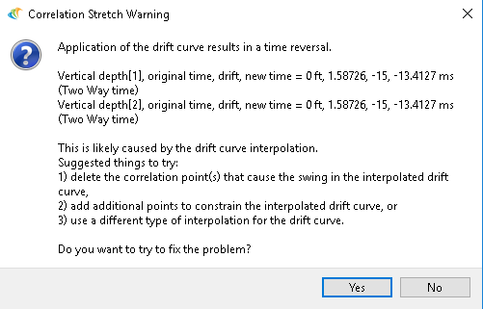
Hampson Russell Exercise – Time Shift

Slide 26
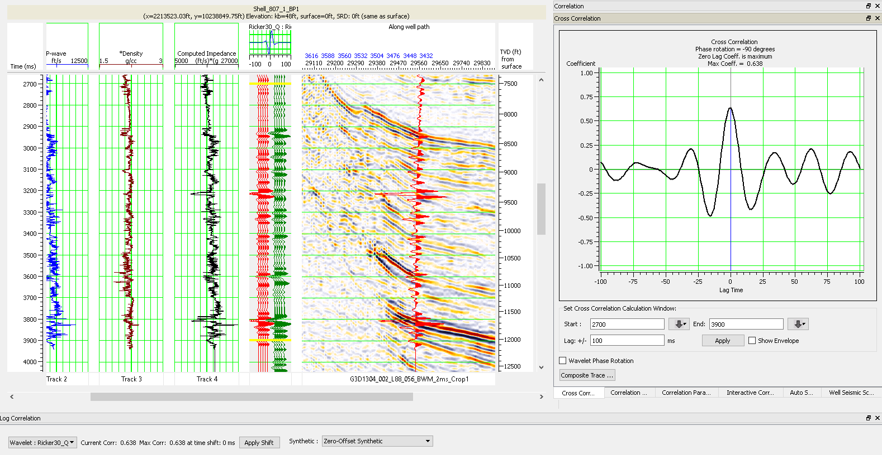
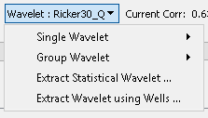
Hampson Russell Exercise – Ricker Wavelet

Slide 27
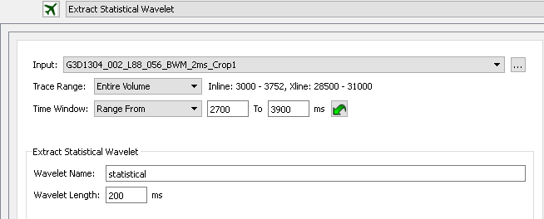
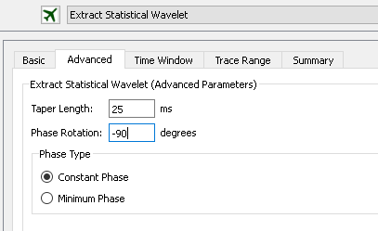
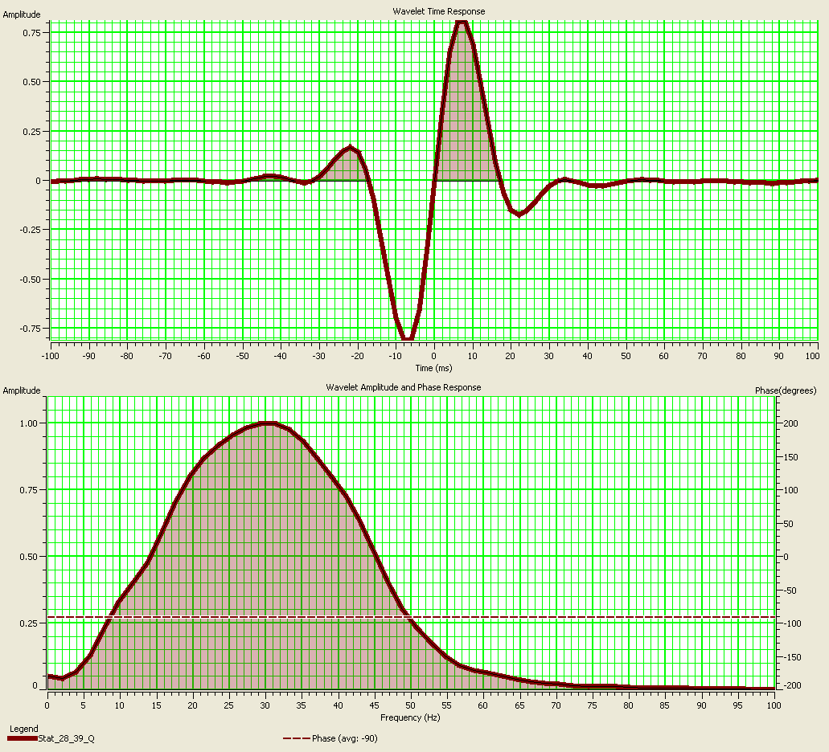
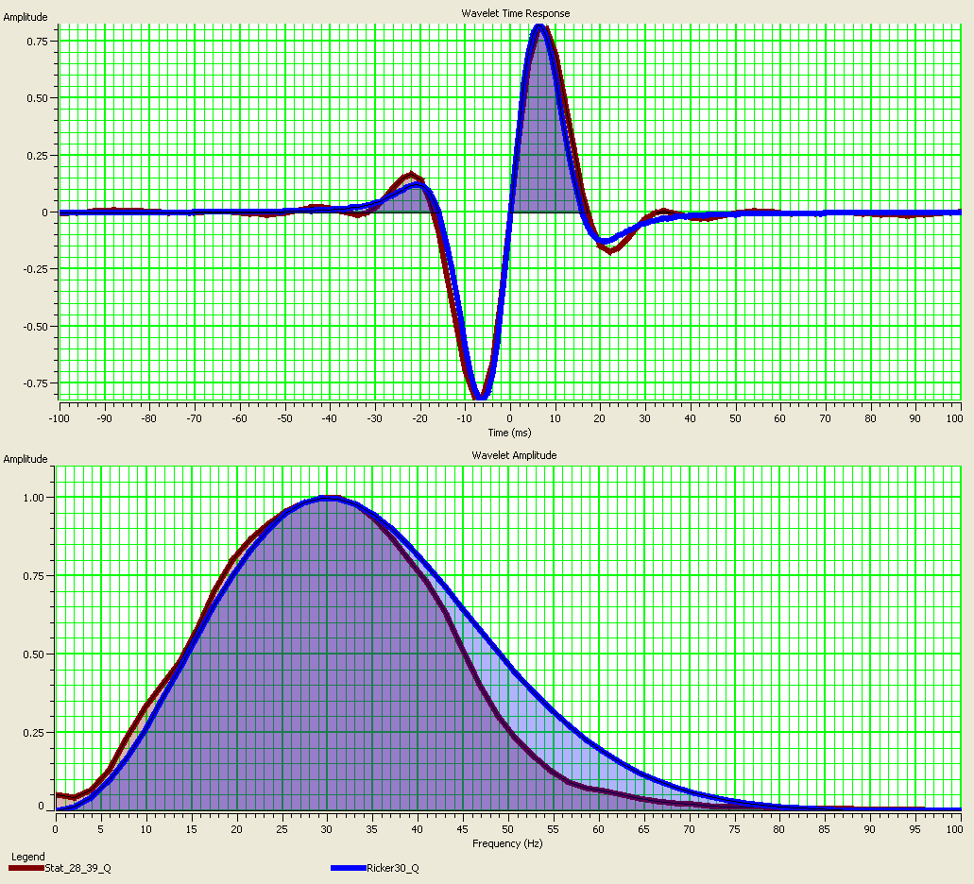
Hampson Russell Exercise – Statistical Wavelet
Wavelet – Statistical vs. 30Hz Ricker Quad

Slide 28
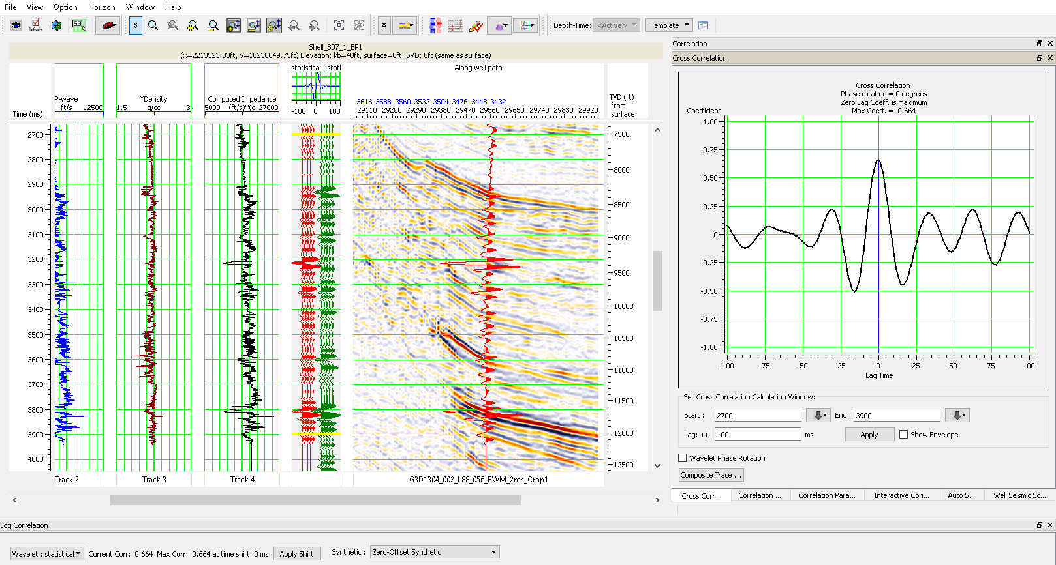
Hampson Russell Exercise – Statistical Wavelet

Slide 29
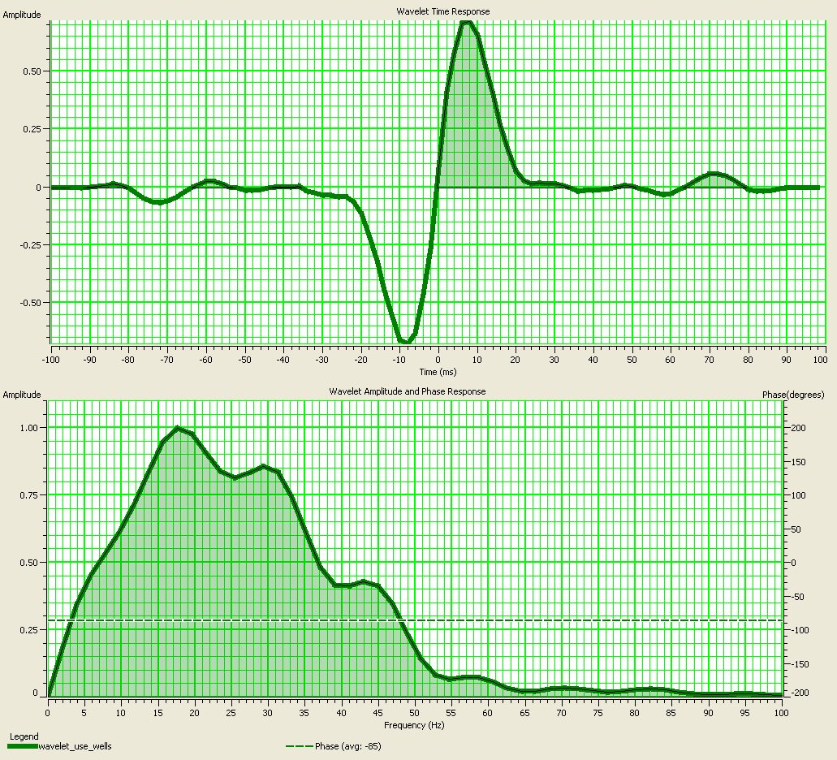
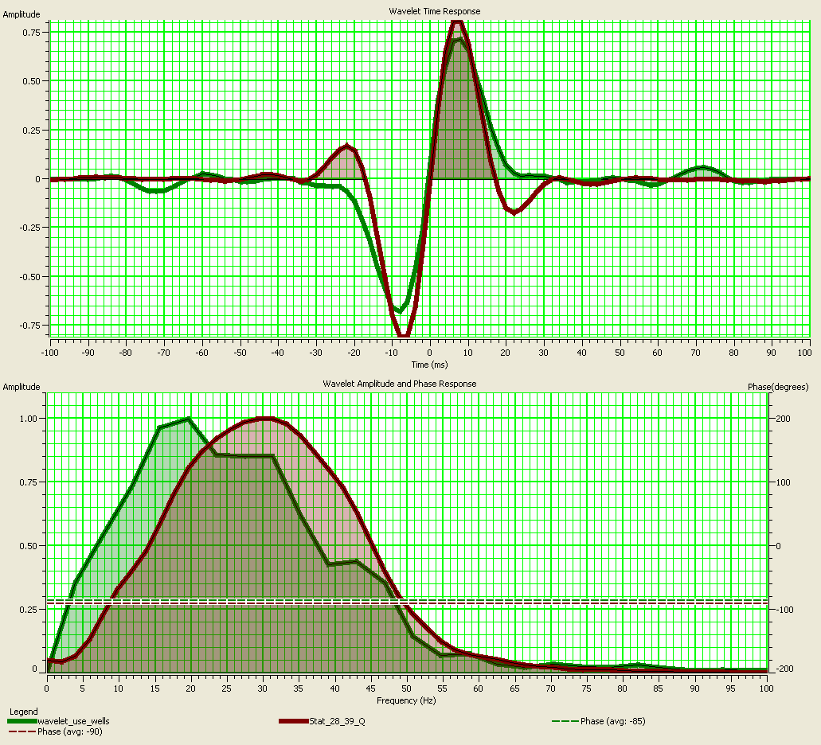
Hampson Russell Exercise – Wavelet Using Wells
Wavelet – Statistical vs. Using Wells

Slide 30
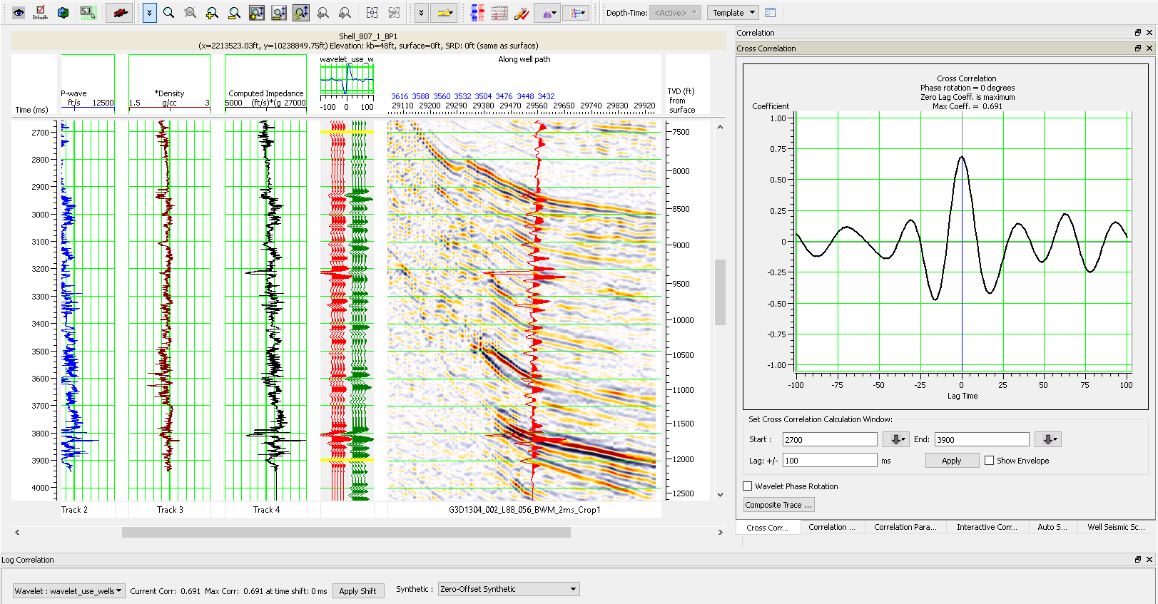
Hampson Russell Exercise – Wavelet Using Wells

Slide 31
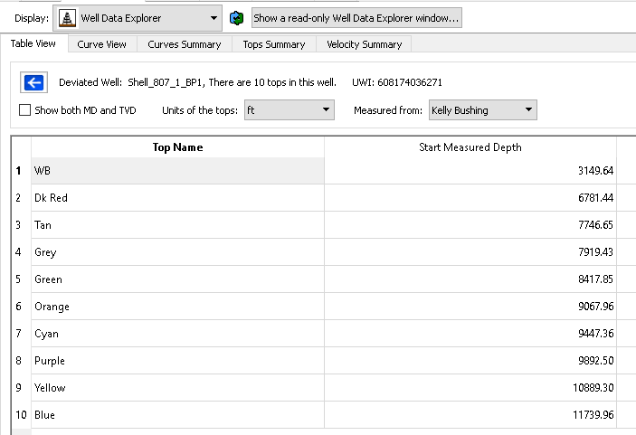
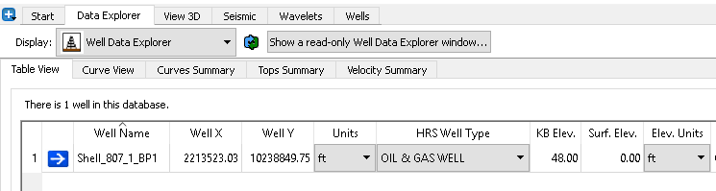
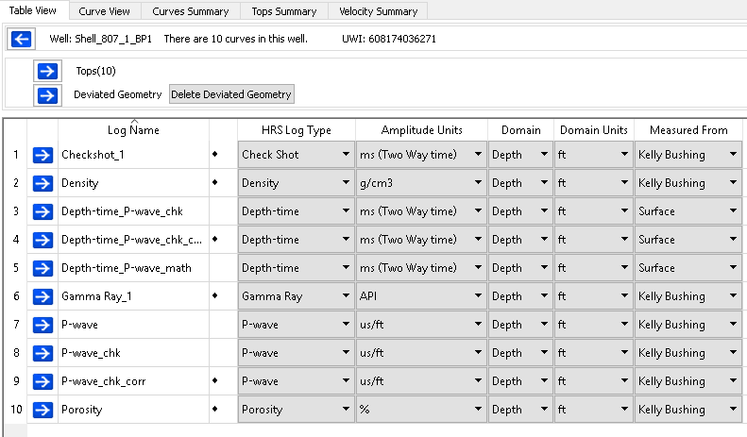
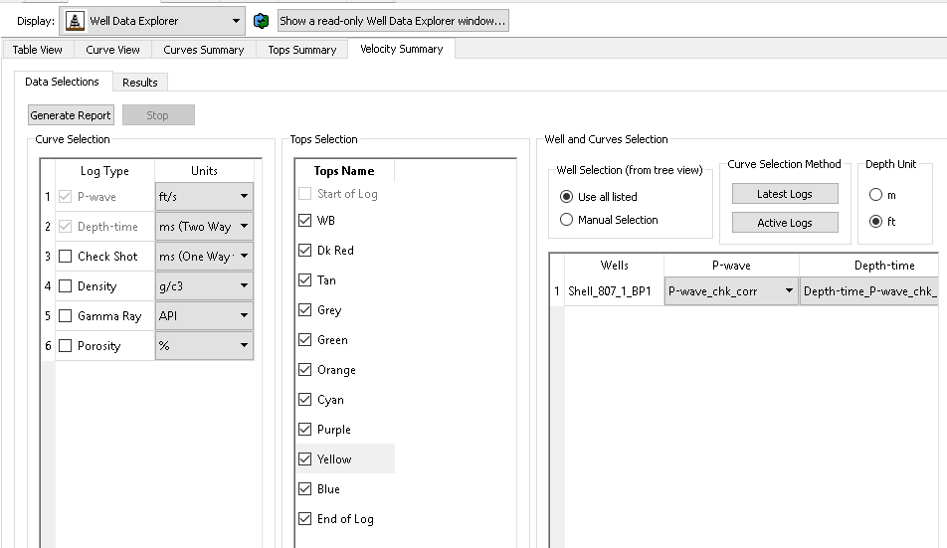
Hampson Russell Exercise – Well Tops Report

Slide 32
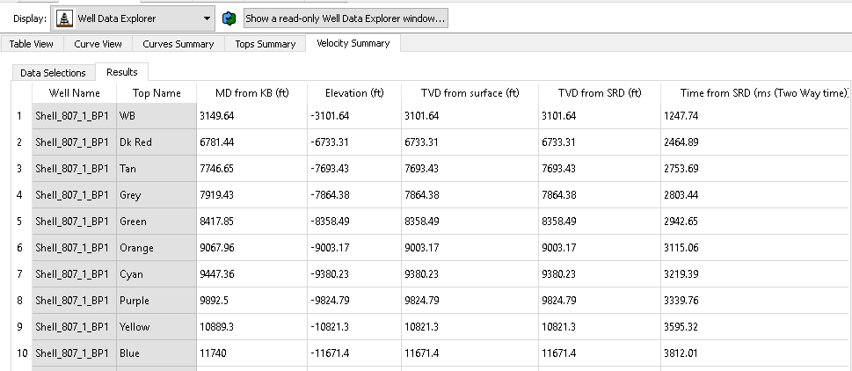
Hampson Russell Exercise – Well Tops Report

